Slide 1

Architecture & Furniture& Advertising Look Book
good works for good brands...

Slide 2
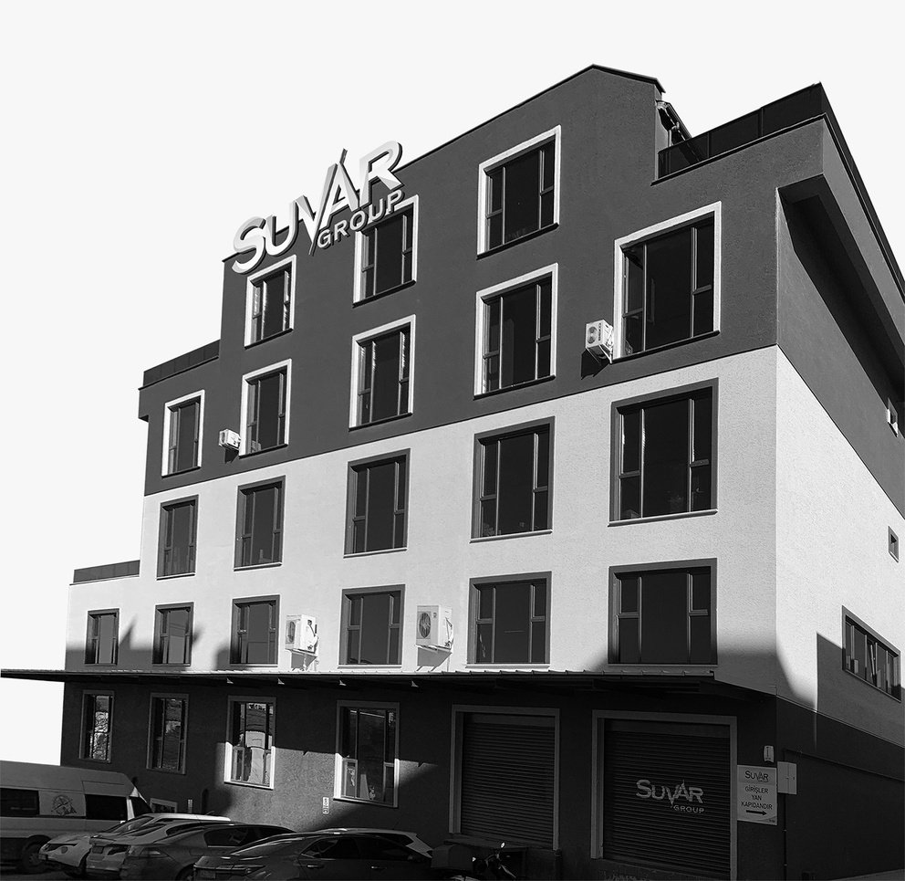
ABOUT US
SUVAR GROUP
We have been sharing our experience in the sector with more than 30 valuable brands since 2007.
Strong partnerships are the signature of the implementation of our core values; special brand communication analysis, smart designs, on-time worldwide production and delivery, extraordinary promotional experience create our difference today and enable us to be the privileged as official audited partner of important cosmetics players in Turkey and the world.

Slide 3
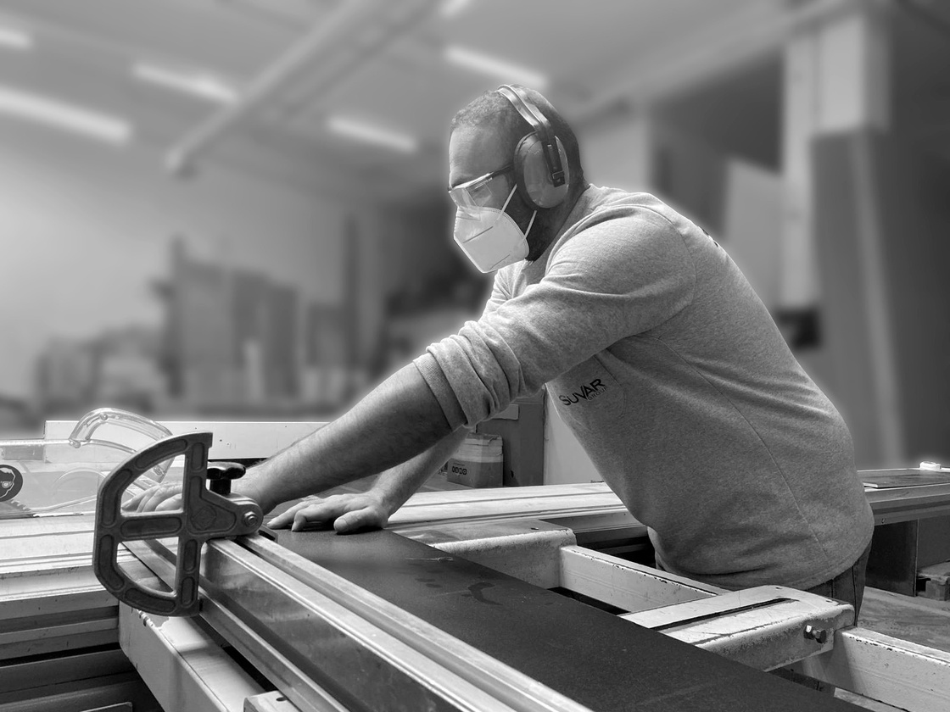
WHY US ?
SUVAR GROUP
Our strength lies in delivering high-quality expertise in event design, stand production, and immersive brand experiences, we bring stories to life. Through a professional merchandising perspective, we optimize design, cost efficiency, and sustainability to ensure maximum performance and value while integrating your brand's unique sensitivities into the design process.
‘’The Strength of Your Brand Identity, The Power of Your Trusted Partnership’’

Slide 4
OUR EXPERTISE
SUVAR GROUP
Architectural Application Services
End to end Project Management and Application
Retail Furniture Design & Production
Prototypes, production, and installation of furniture for stores, showrooms, and pop-up spaces
Advertising Space Implementation
Signages
3D logos, interactive displays and kiosks
Visual Merchandising Solutions
Tailored merchandising strategies to highlight key products, seasonal collections, or promotions.
Sustainable Design and Production
Implementing energy-efficient and recyclable solutions
Brand Sensitivity & Customization
Collaborative approach with design teams to understand of brand values, aesthetics, and customer expectations.

Slide 5





OUR PROCESS
SUVAR GROUP
Discovery & Consultation
Concept Design & Prototyping
Branding & Logo Development
Architectural & Construction Design & Application
Advertising Space Design & Implementation
Production & Installation

Slide 6
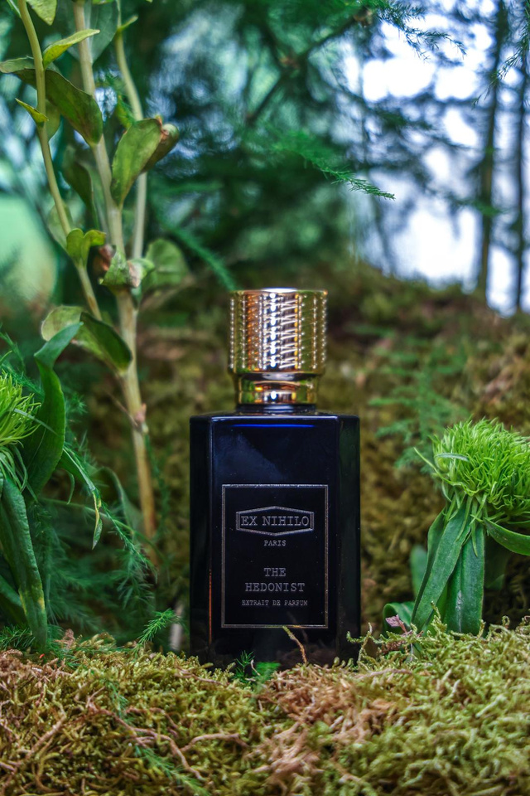
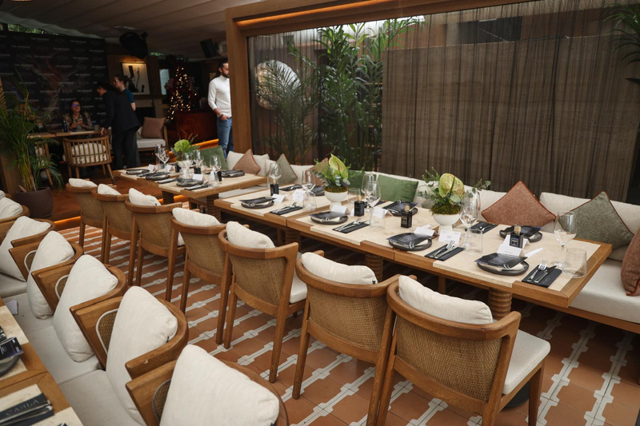
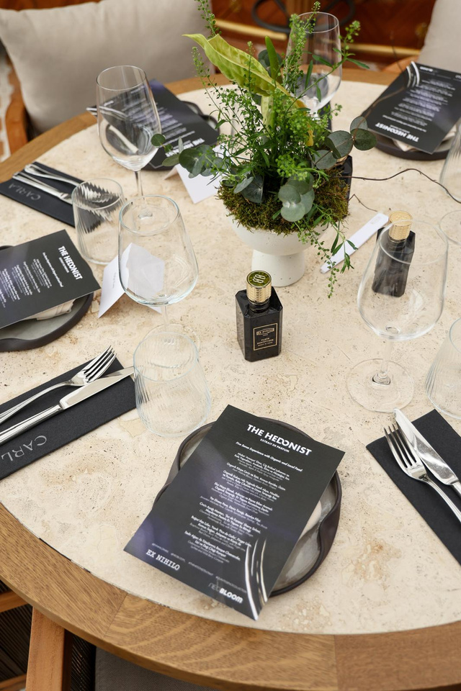
OUR WORKS
Project Name
Location
EX NIHILO THE HEDONIST LAUNCH
Carla Kuruçeşme İstanbul/Türkiye
SUVAR GROUP
Ex Nihilo's "The Hedonist" perfume, the design centered on elegance and natural luxury. The event space reflected the perfume's sophistication and luxury, while also highlighting the raw power of nature.

Slide 7
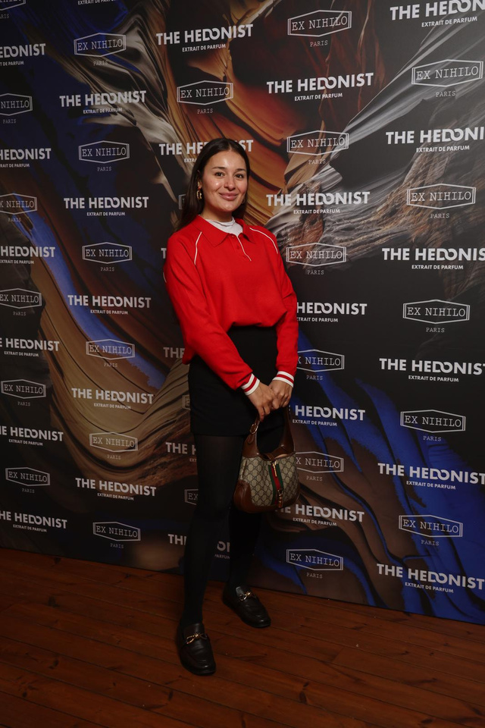
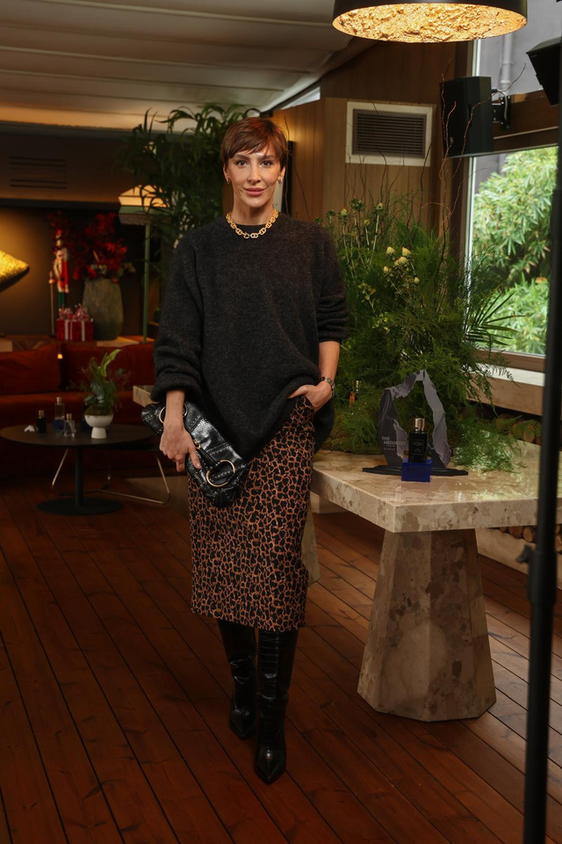
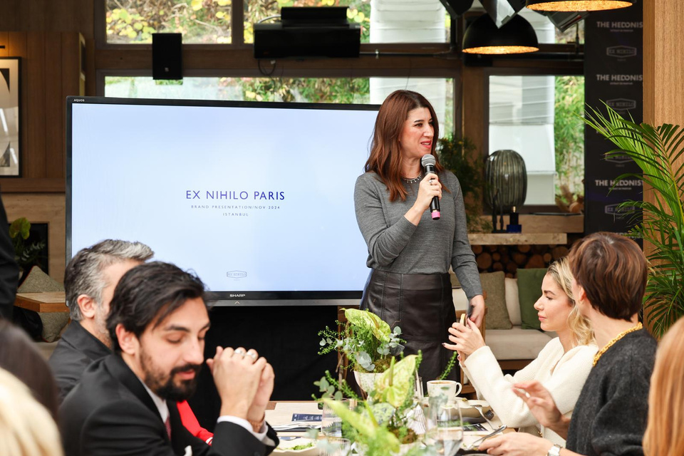
OUR WORKS
Project Name
Location
EX NIHILO THE HEDONIST LAUNCH
Carla Kuruçeşme İstanbul/Türkiye
SUVAR GROUP
Some photos of the participants

Slide 8
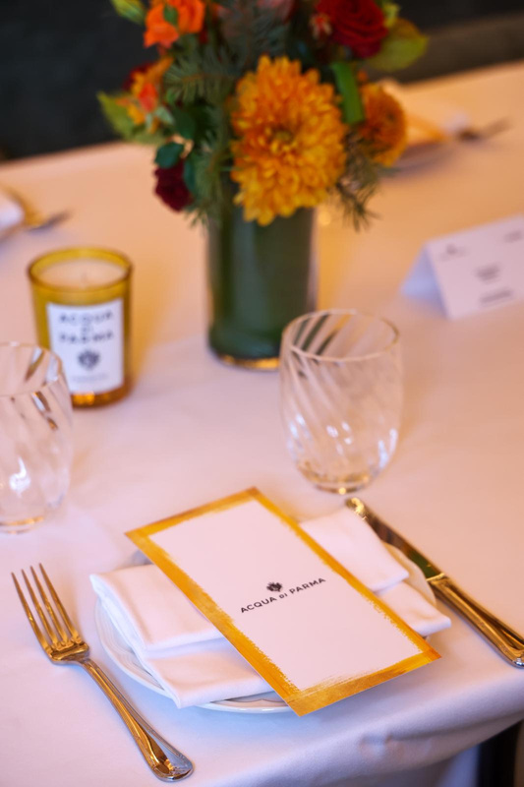
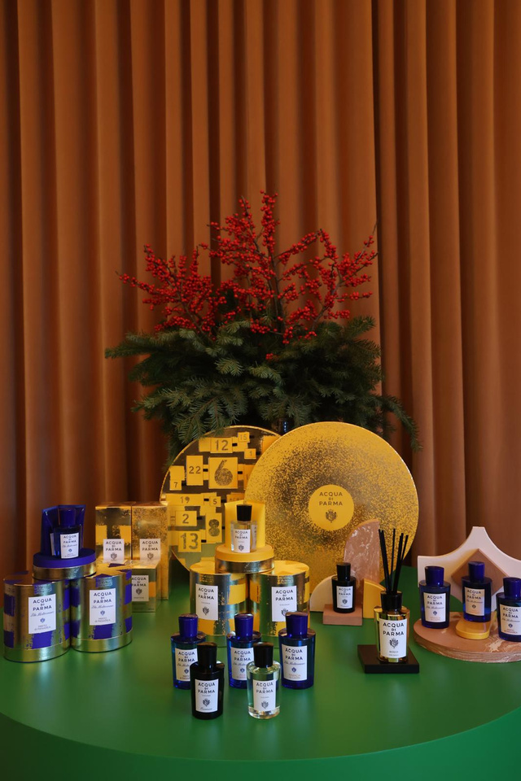
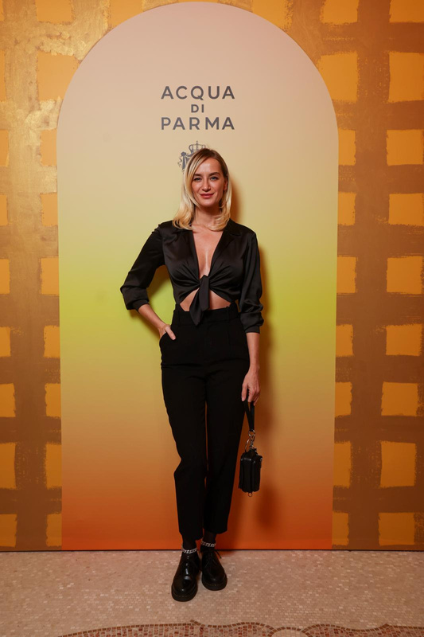
OUR WORKS
Project Name
Location
ACQUA DI PARMA EVENT
Bardot Zorlu Center İstanbul/Türkiye
SUVAR GROUP
The main theme of the event aimed to highlight rich and warm colors, natural materials, and a chic atmosphere.

Slide 9
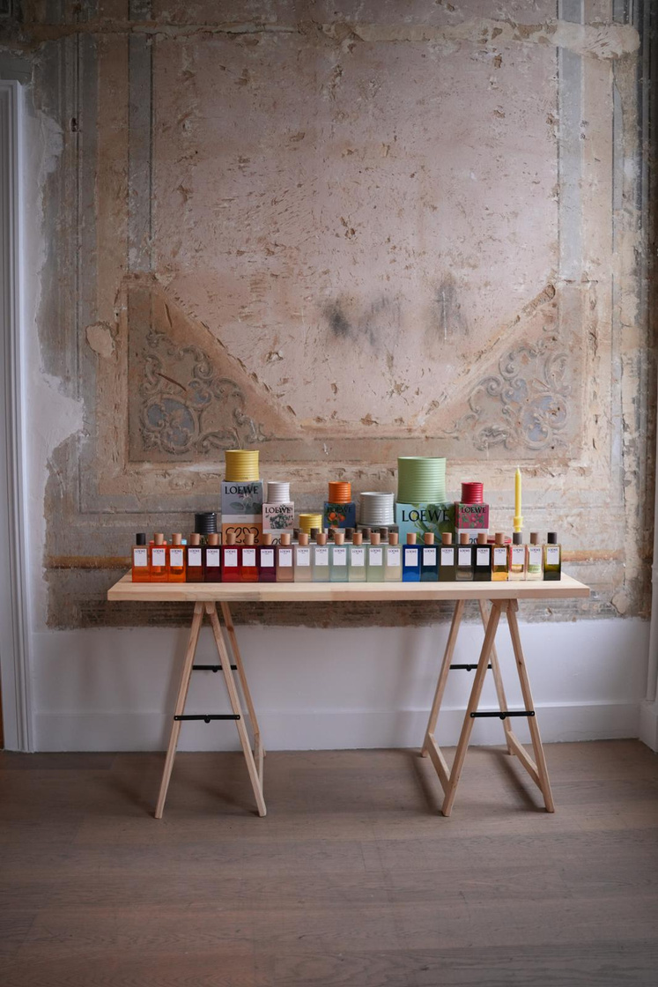
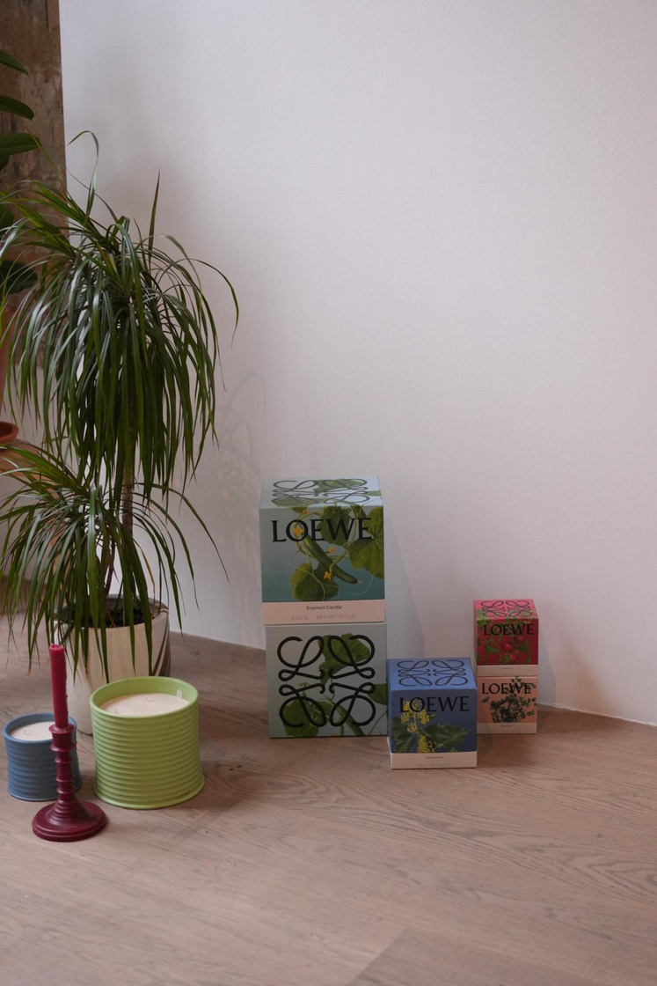
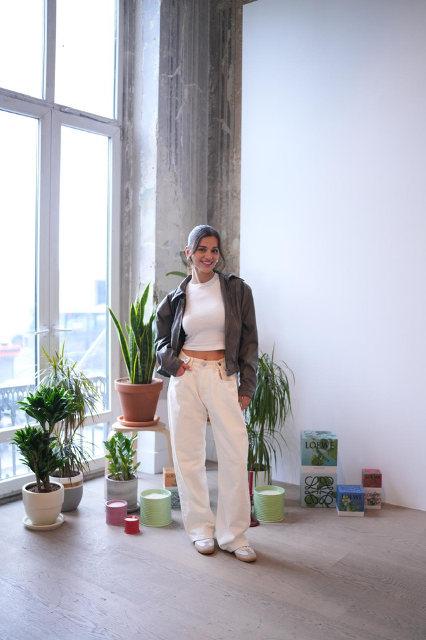
OUR WORKS
Project Name
Location
LOEWE
Galerist İstanbul/Türkiye
SUVAR GROUP
The event featured
minimalism, artistic details, and
modern touches at the forefront.

Slide 10
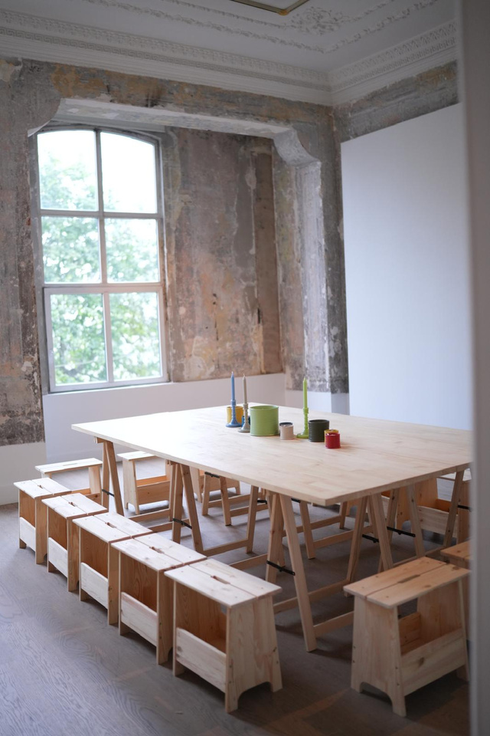
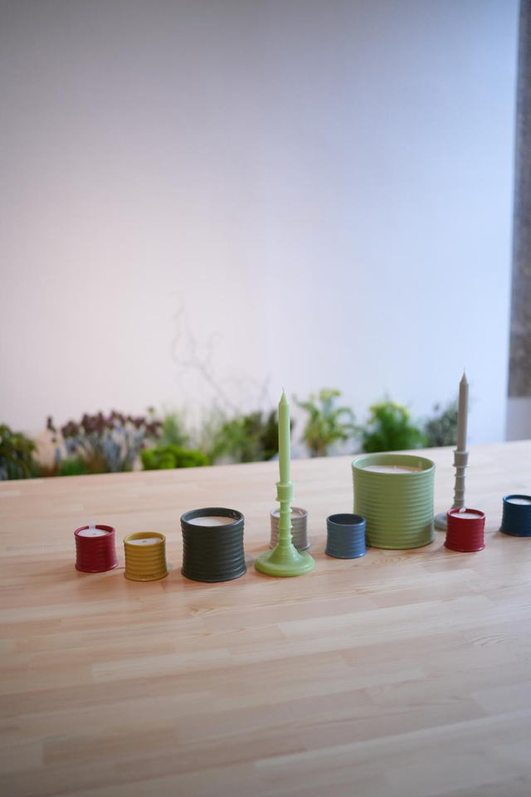
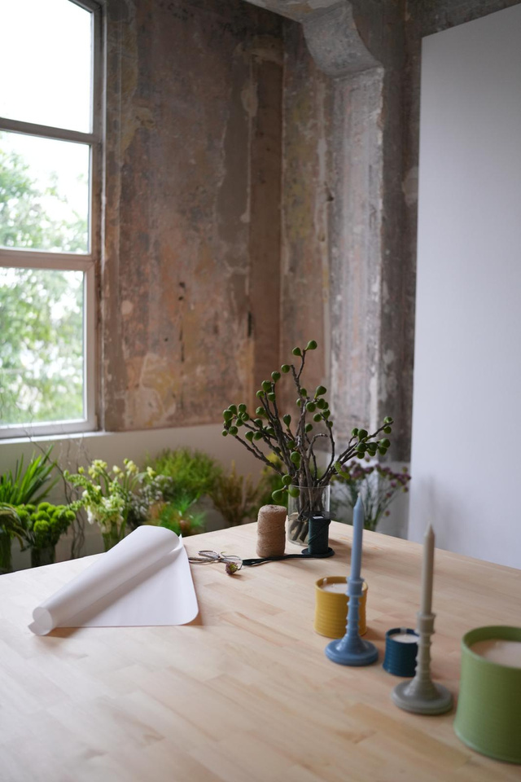
OUR WORKS
Project Name
Location
LOEWE
Galerist İstanbul/Türkiye
SUVAR GROUP
The main theme of the event combined design, art, and culture. By highlighting the brand's elegant and innovative aspects, we aimed to bring together luxury and originality in every detail.

Slide 11
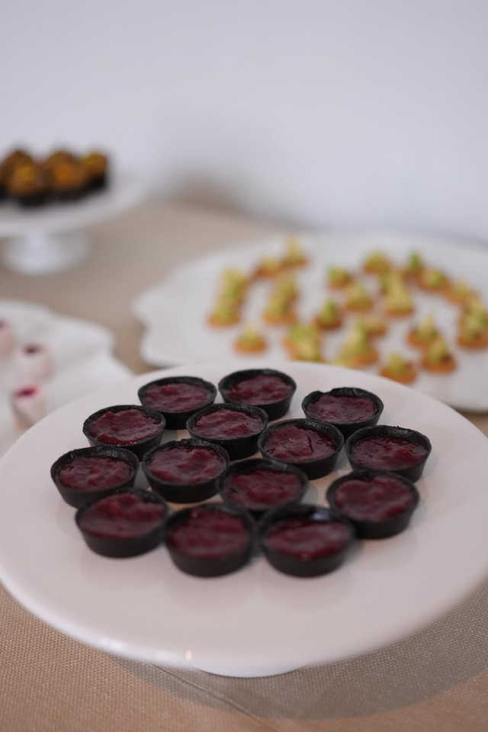
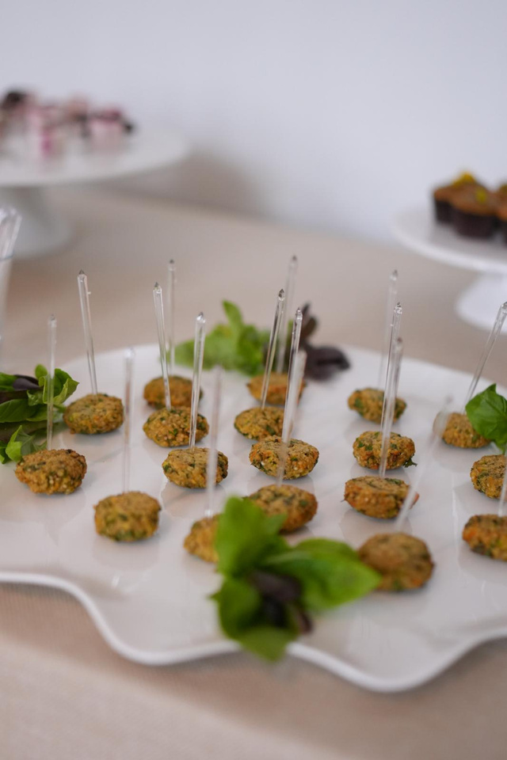
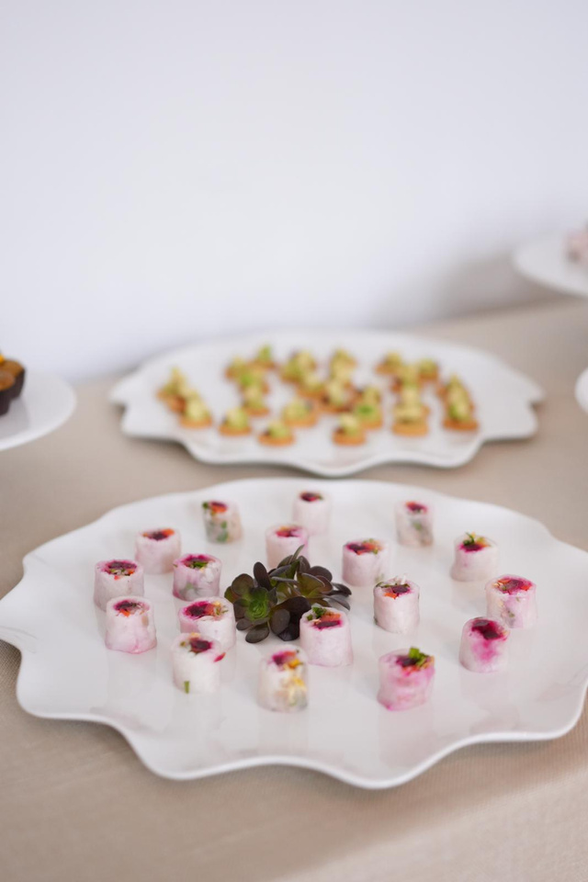
OUR WORKS
Project Name
Location
LOEWE
Galerist İstanbul/Türkiye
SUVAR GROUP
Delicious Presentation: The Catering Experience at the Event

Slide 12
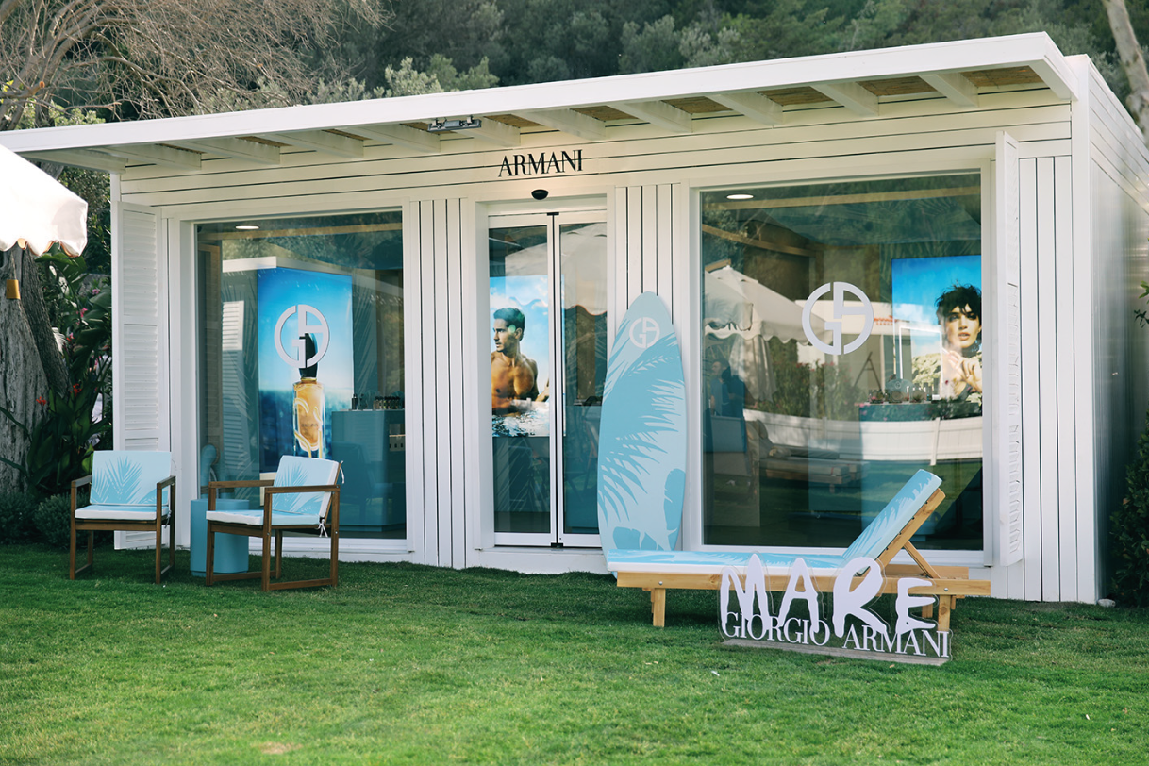
OUR WORKS
Project Name
Location
ARMANI MARE LAUNCH
Lucca Beach /Bodrum/Türkiye
SUVAR GROUP

Slide 13
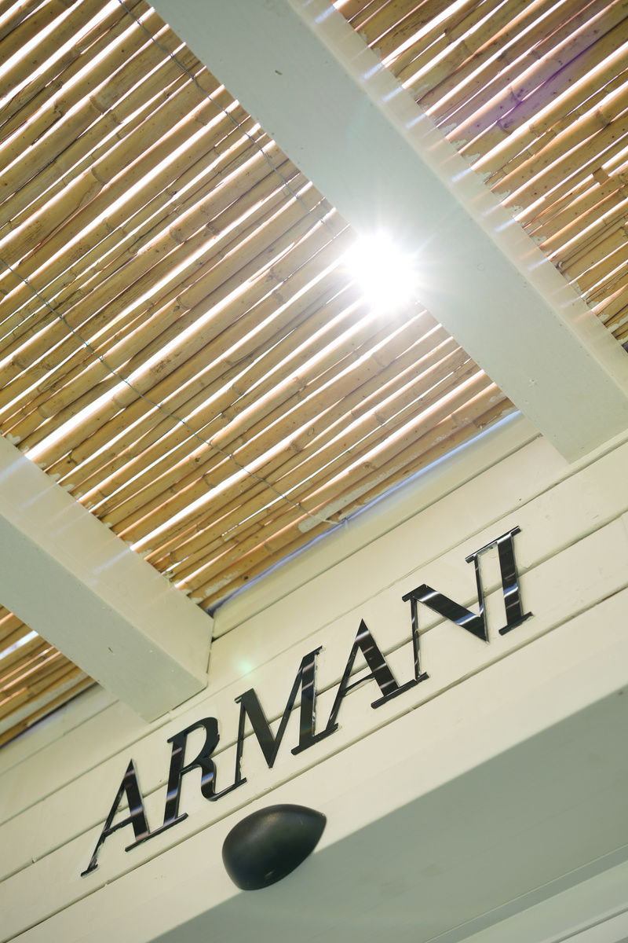
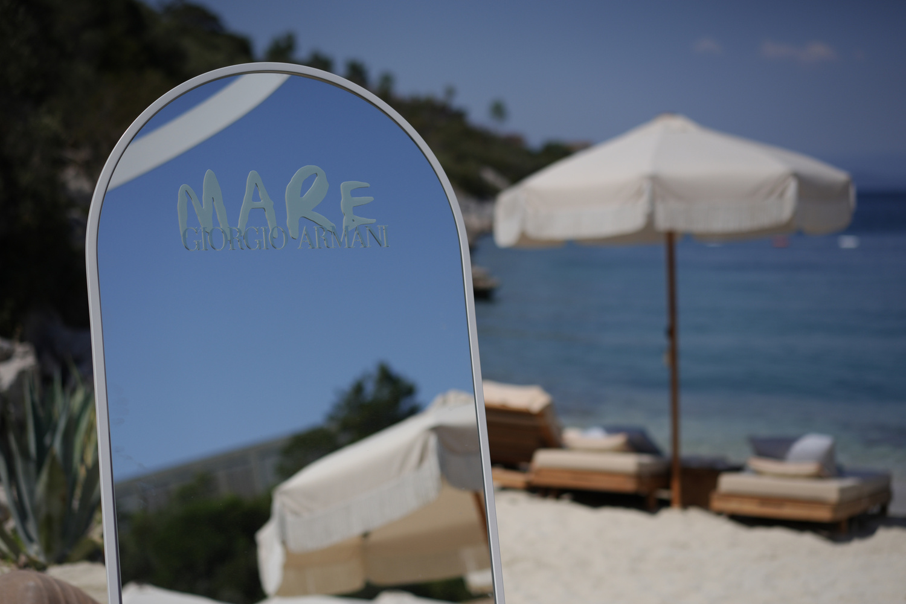
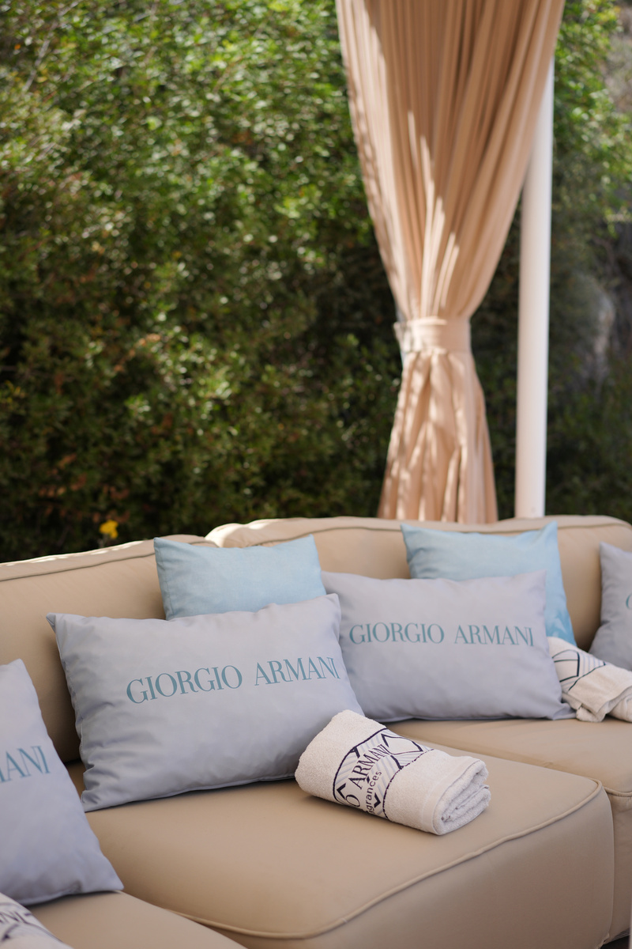
OUR WORKS
Project Name
Location
ARMANI MARE LAUNCH
Lucca Beach /Bodrum/Türkiye
SUVAR GROUP
The main theme drew inspiration from the global success of Armani Mare in places like Saint Tropez and Porto Cervo, blending Mediterranean elegance with the brand's visibility in harmony with nature.

Slide 14
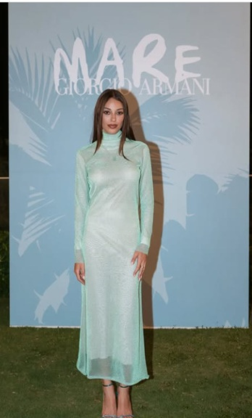
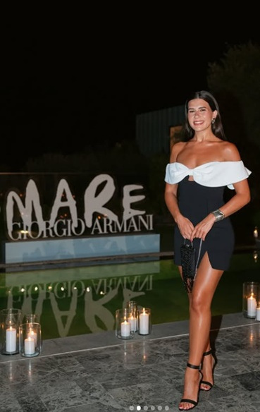
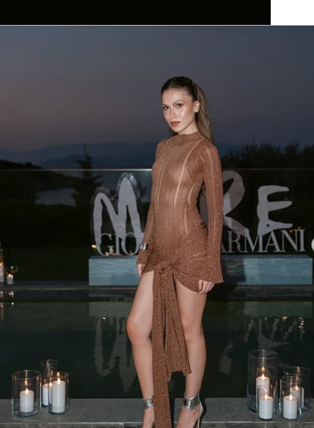
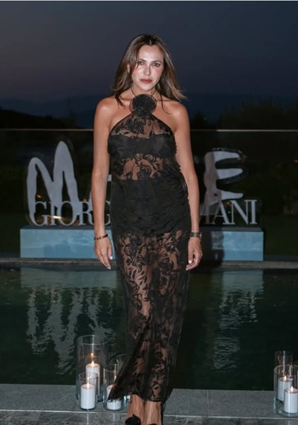
OUR WORKS
Project Name
Location
ARMANI MARE LAUNCH
Lucca Beach /Bodrum/Türkiye
SUVAR GROUP

Slide 15
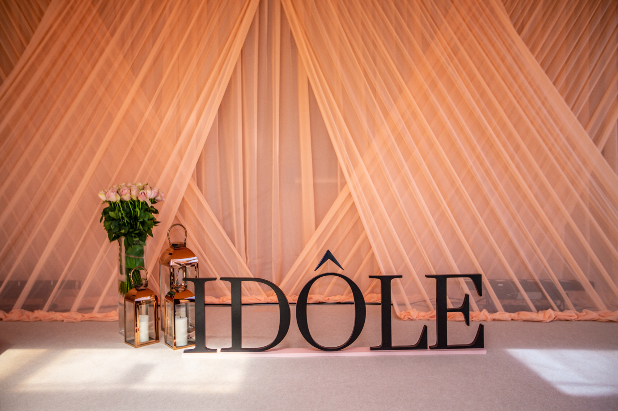
OUR WORKS
Project Name
Location
LANCOME IDOLE LAUNCH
Hilton Maslak İstanbul/Türkiye
SUVAR GROUP

Slide 16
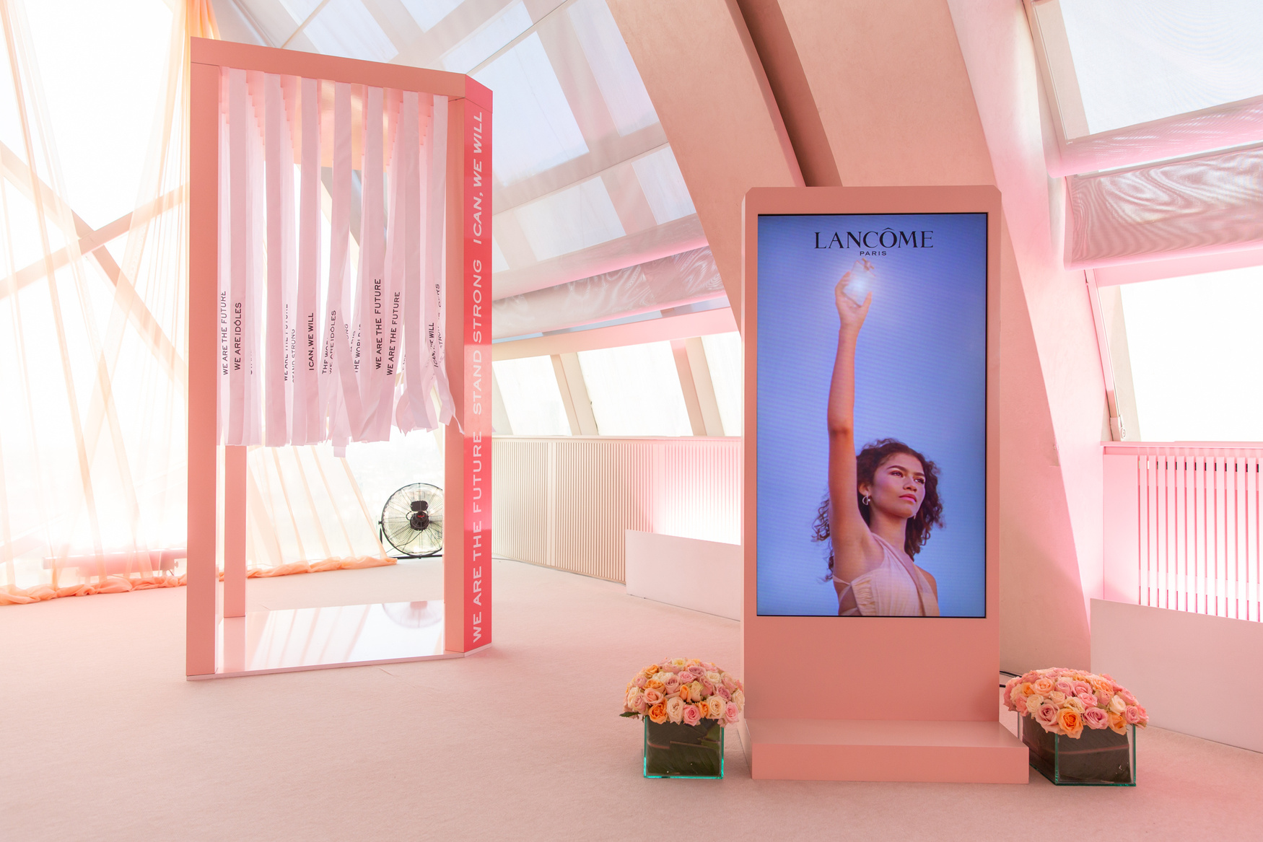
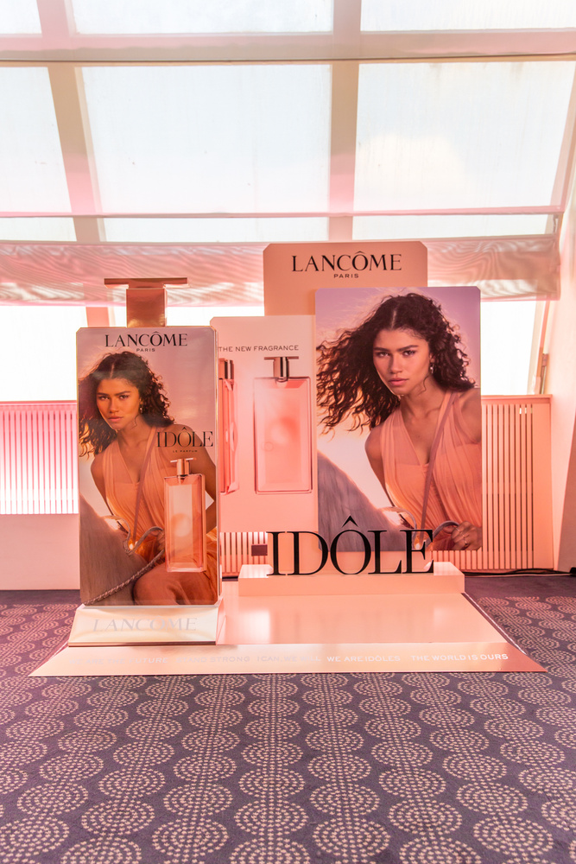
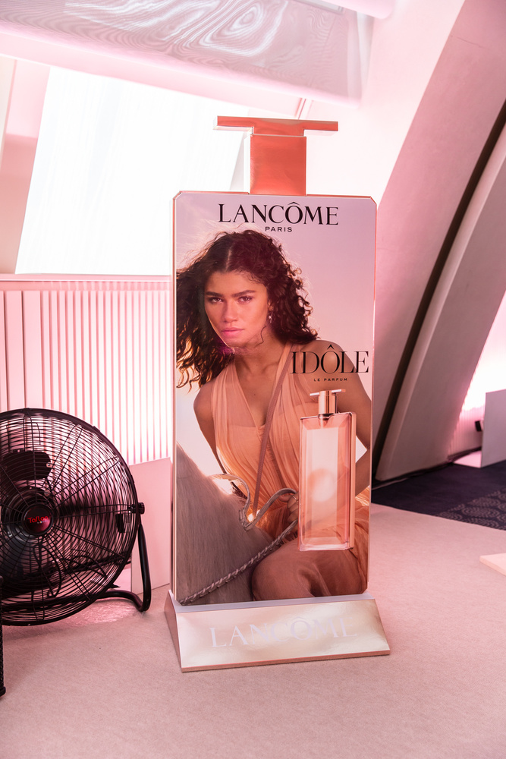
OUR WORKS
Project Name
Location
LANCOME IDOLE LAUNCH
Hilton Maslak İstanbul/Türkiye
SUVAR GROUP
Lancôme Idôle is not just a fragrance, but a symbol of feminine strength and grace.
The main theme was to showcase the celebration of Idôle perfume, which reflects a woman’s strength and elegance,

Slide 17
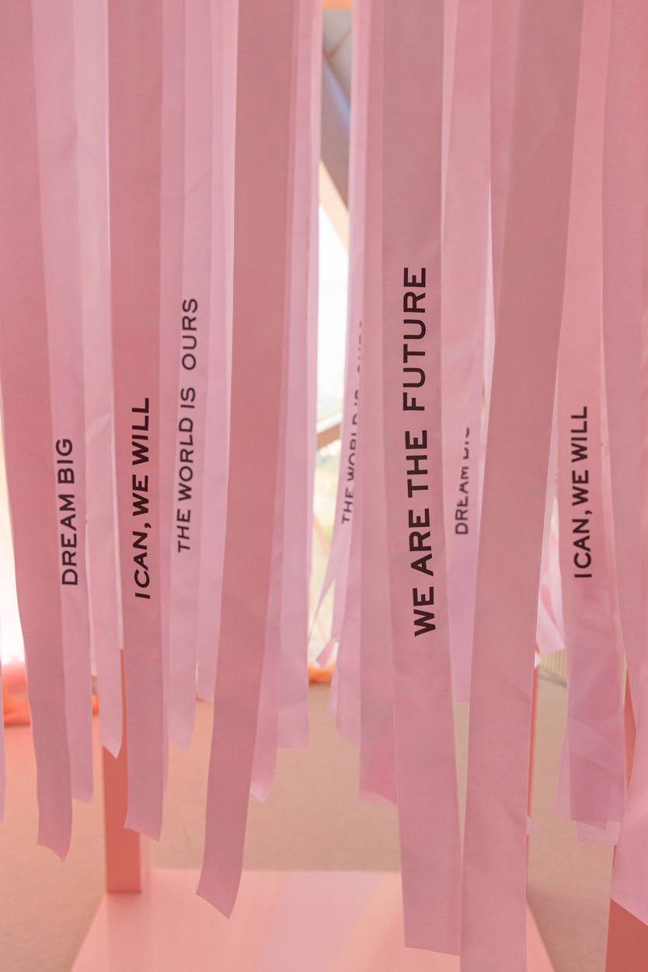
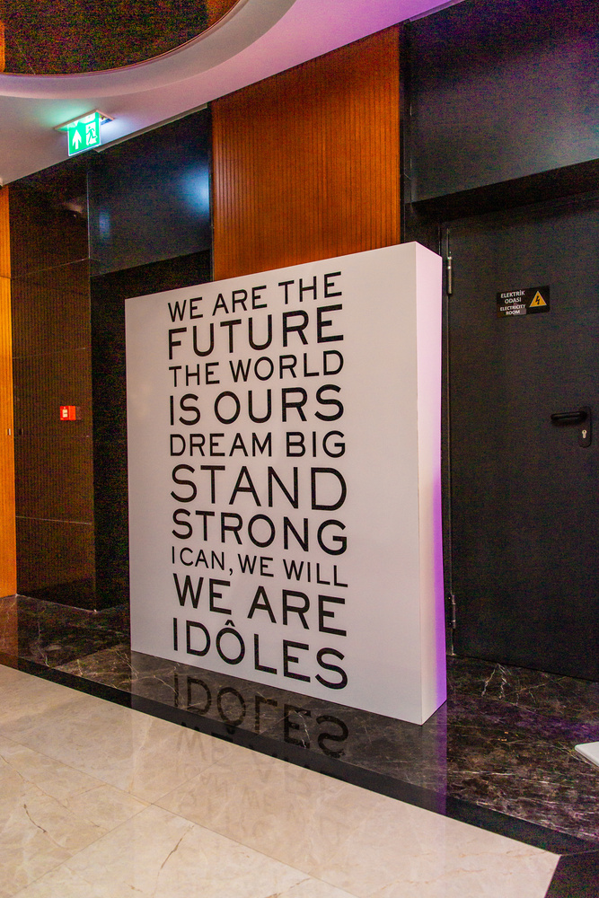
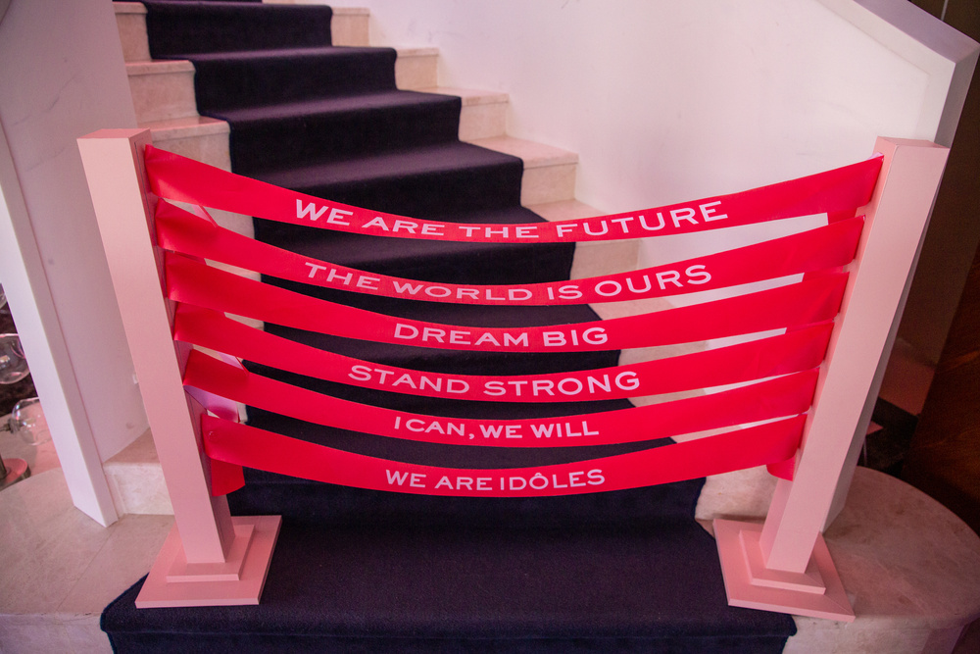
OUR WORKS
Project Name
Location
LANCOME IDOLE LAUNCH
Hilton Maslak İstanbul/Türkiye
SUVAR GROUP
We placed Lancôme’s manifesto at key spots, creating interactive spaces to celebrate the strong, independent, and inspiring women of Idôle not just as an idea, but brought to life in every detail.

Slide 18
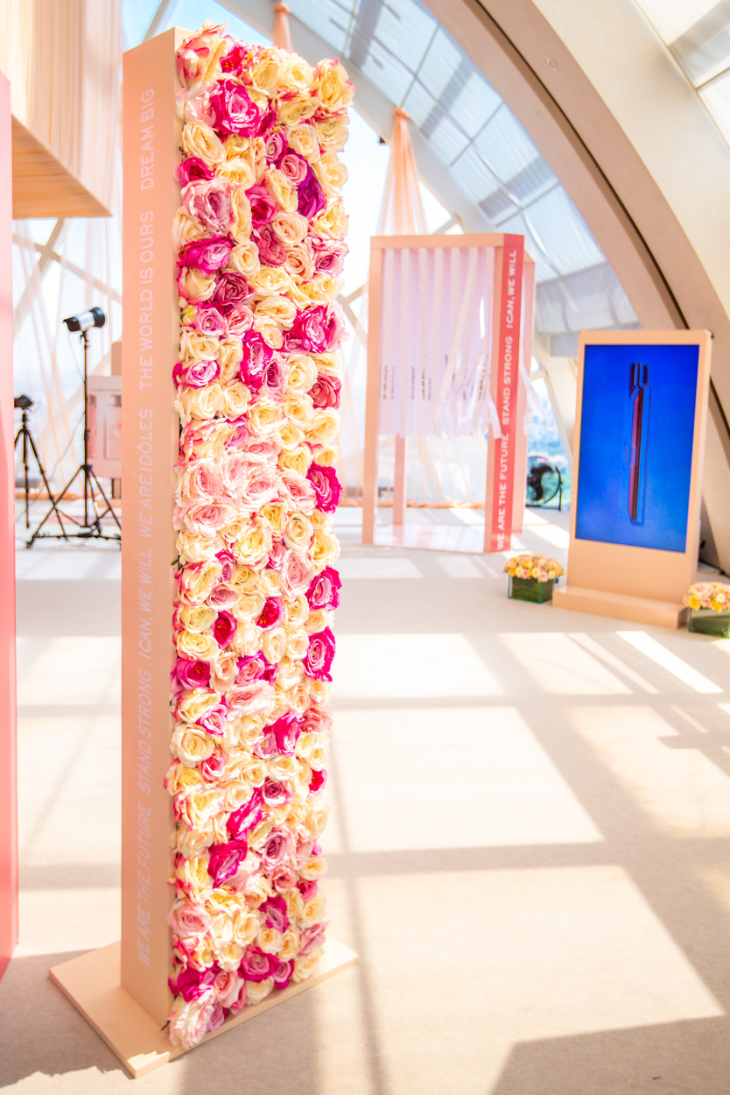
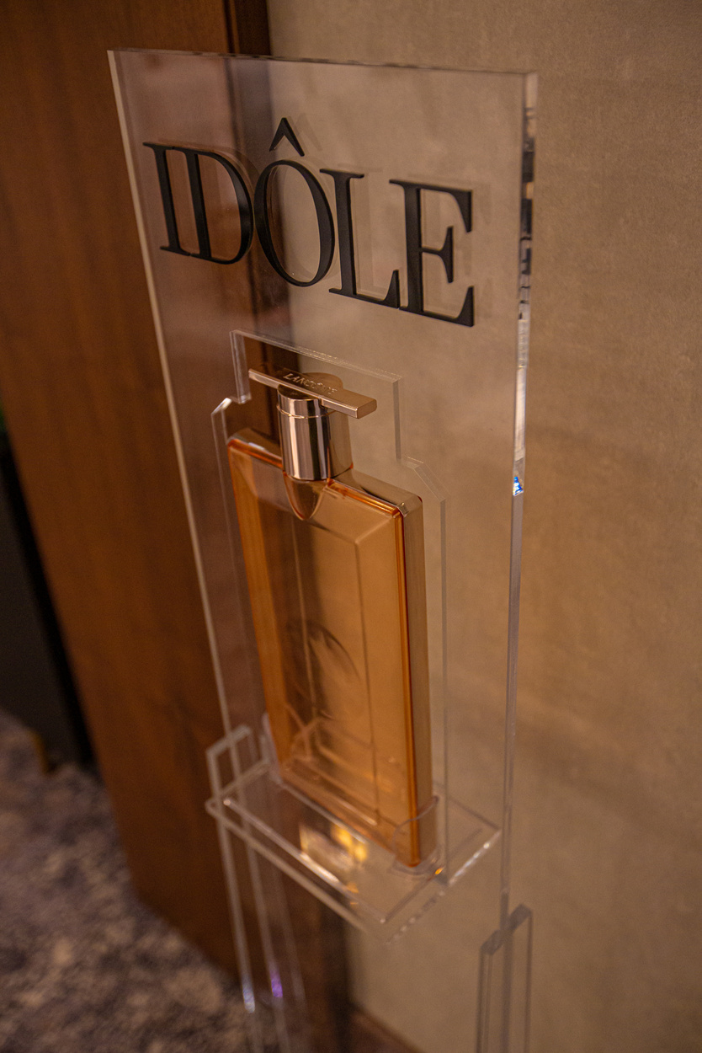
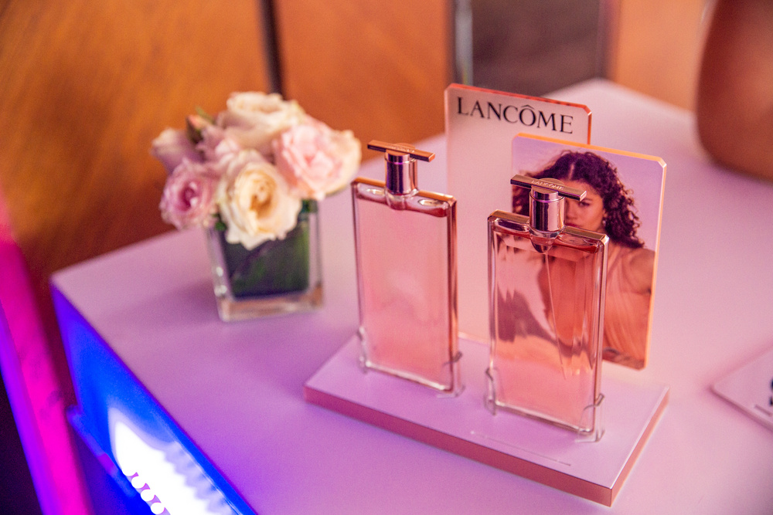
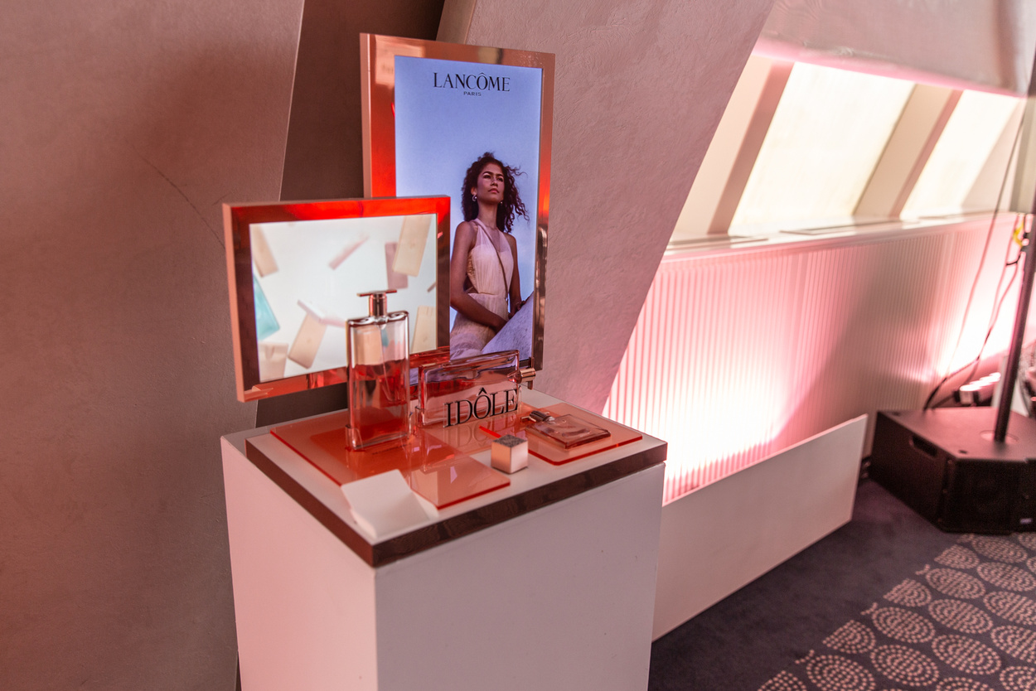
OUR WORKS
Project Name
Location
LANCOME IDOLE LAUNCH
Hilton Maslak İstanbul/Türkiye
SUVAR GROUP
Every detail was crafted to reflect the simple yet powerful essence of Idôle, designed to align with its bold vision and design.

Slide 19
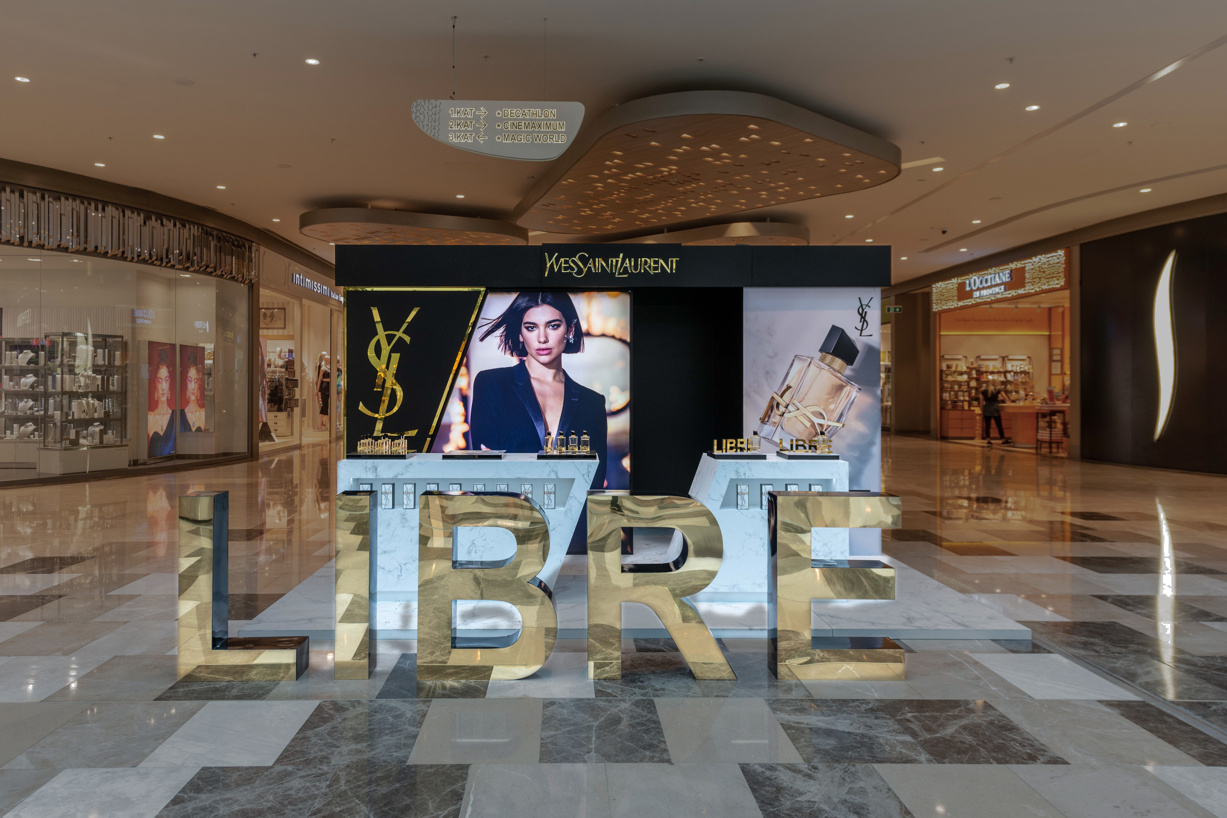
OUR WORKS
Project Name
Location
YSL LIBRE LAUNCH
İstinye Park Mall İstanbul/Türkiye
SUVAR GROUP

Slide 20
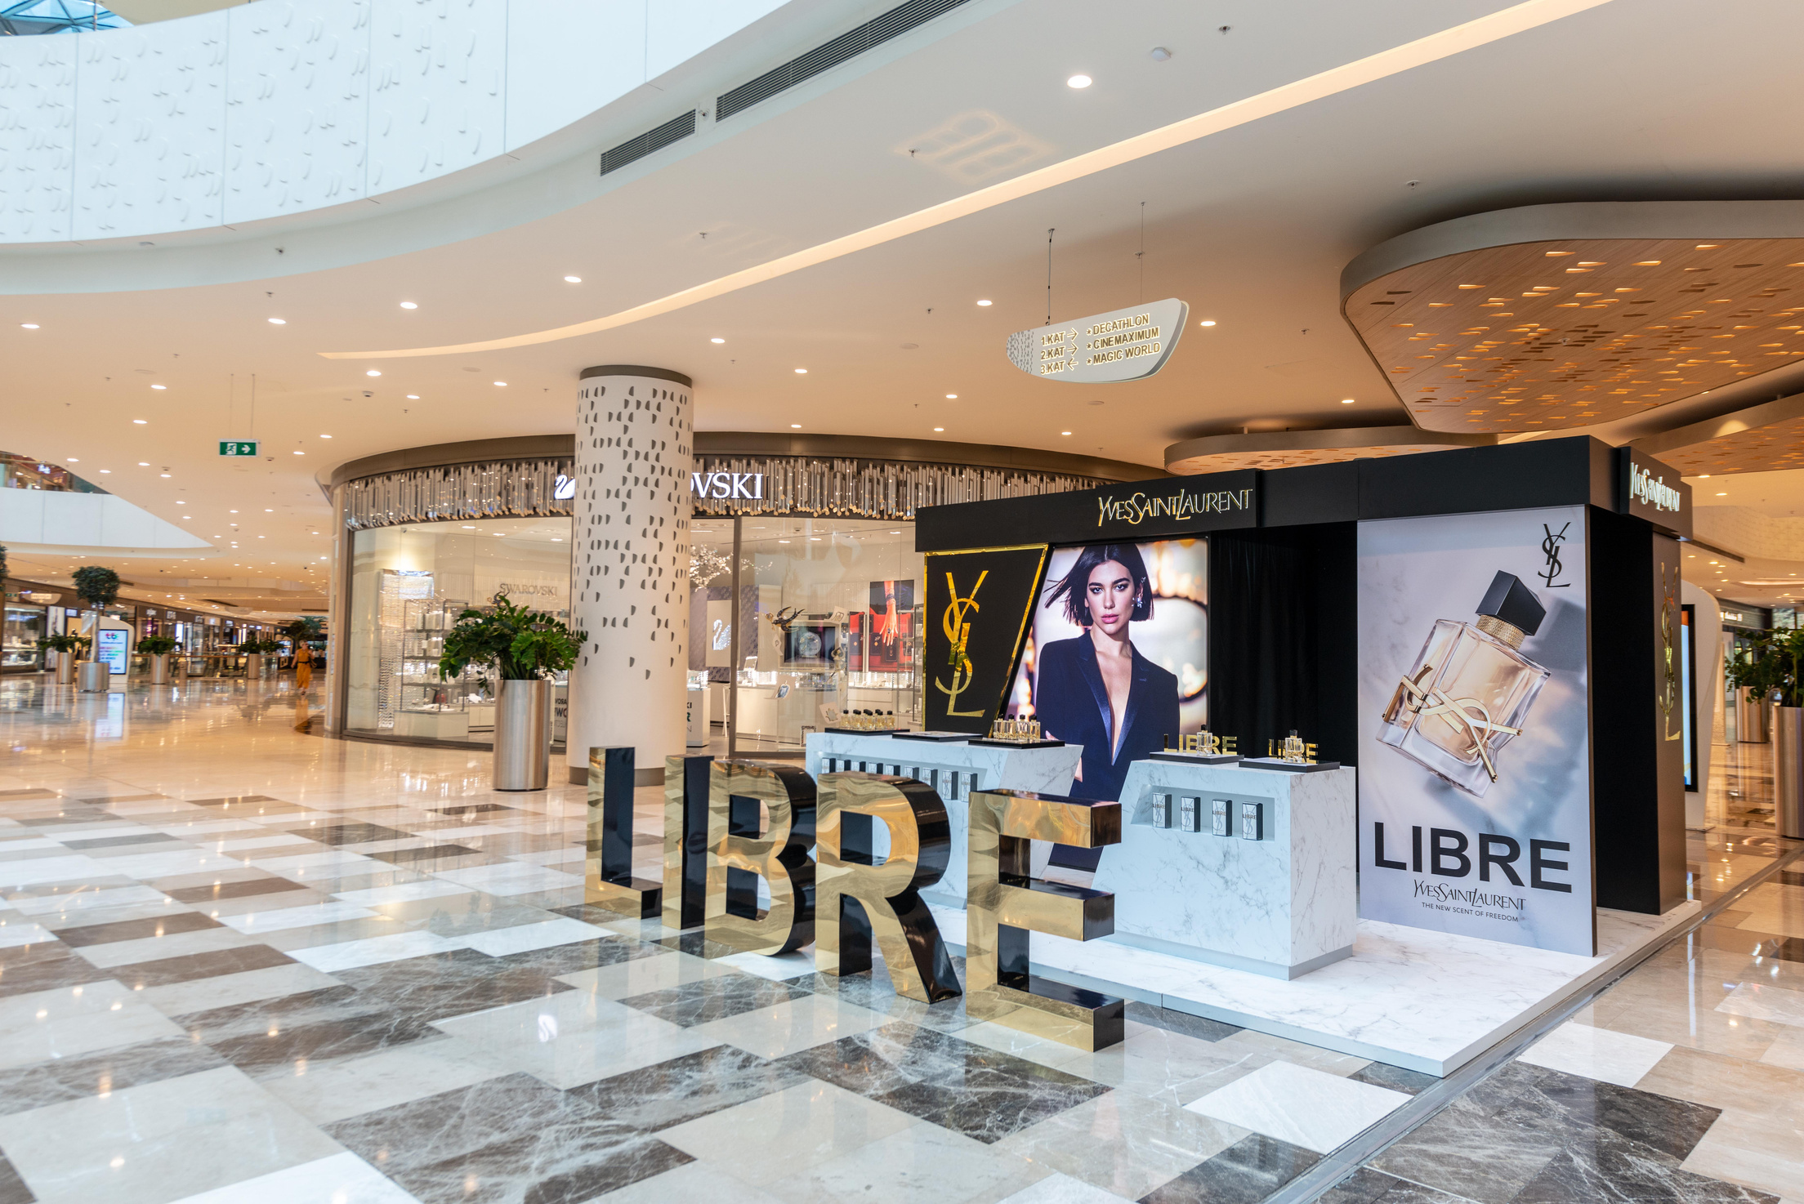
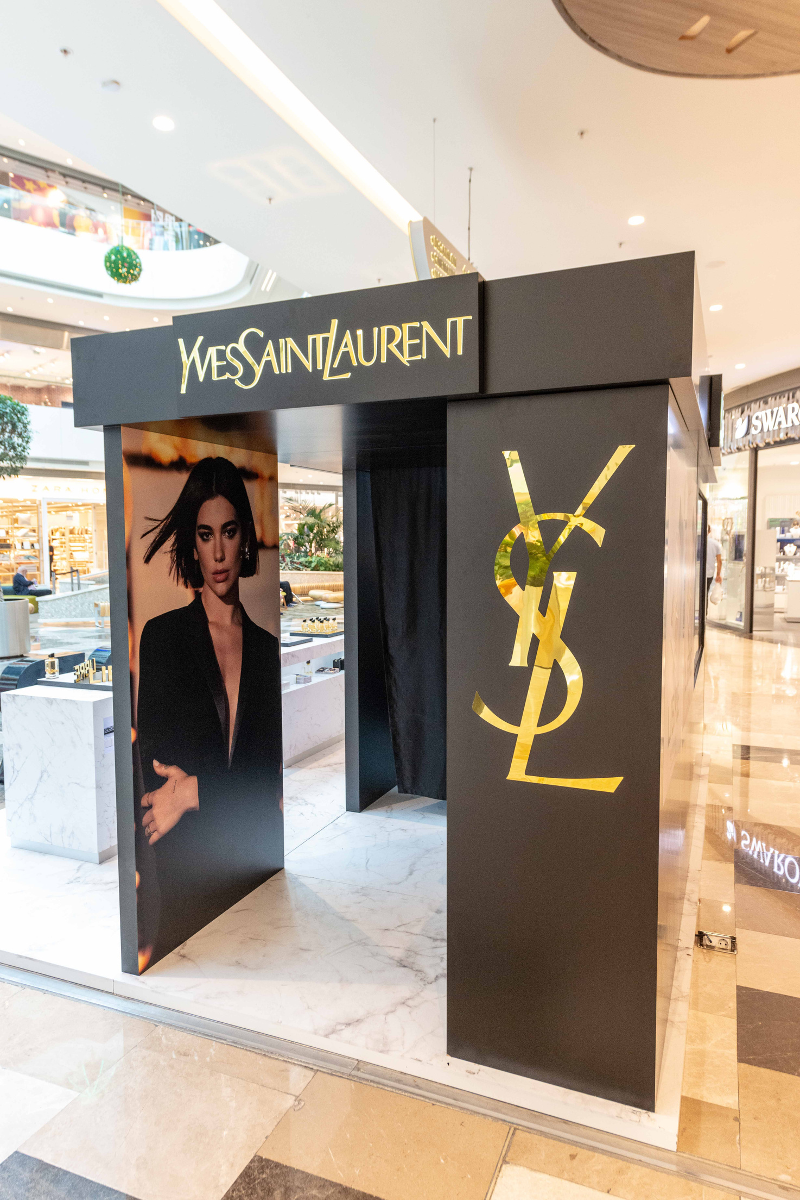
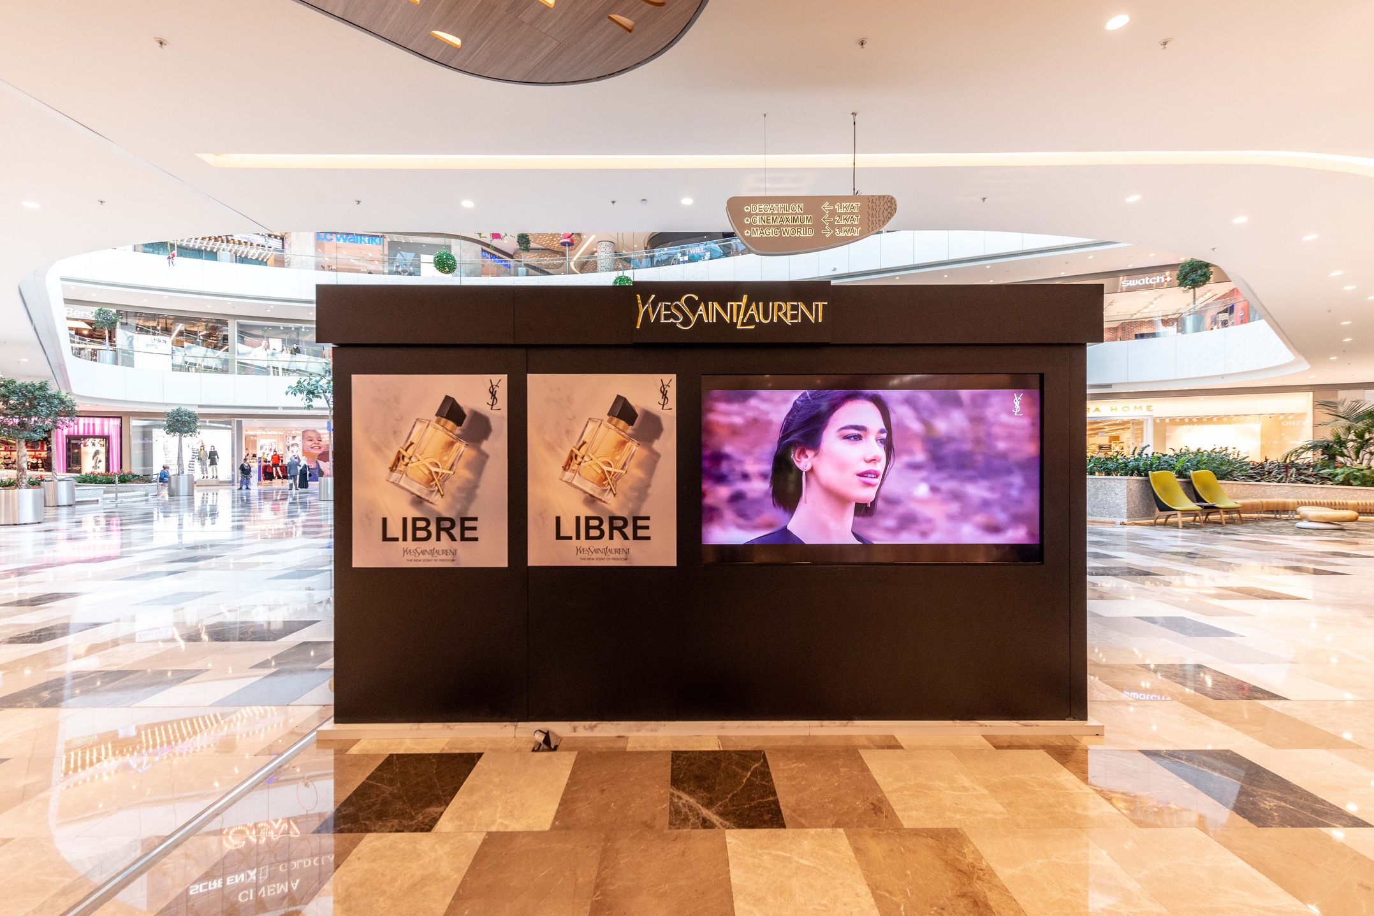
OUR WORKS
Project Name
Location
YSL LIBRE LAUNCH
İstinye Park Mall İstanbul/Türkiye
SUVAR GROUP
The main theme was to highlight the brand's modern, liberated, and elegant image, and to showcase the powerful female character.

Slide 21
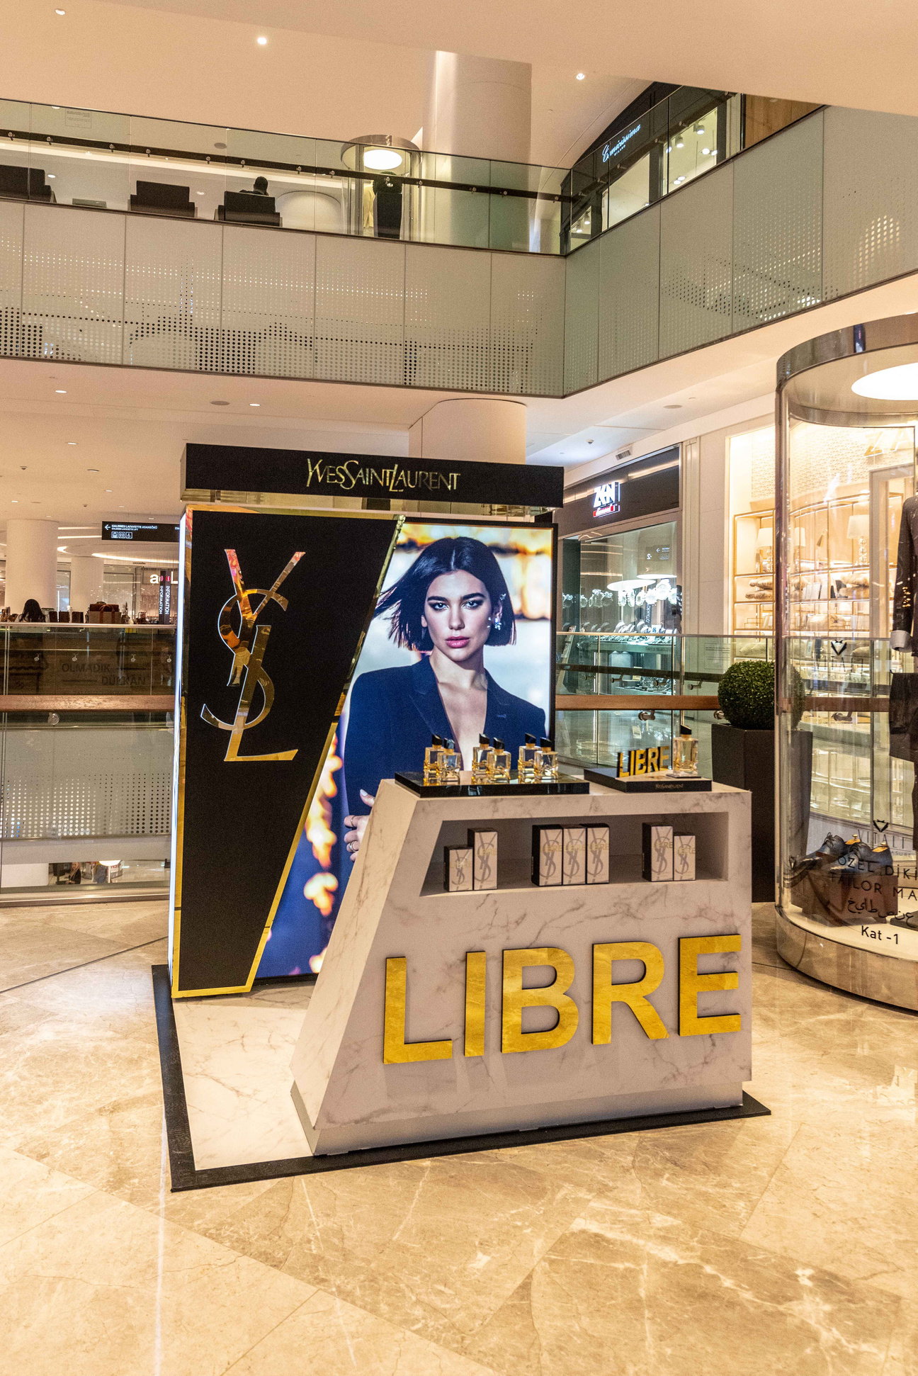
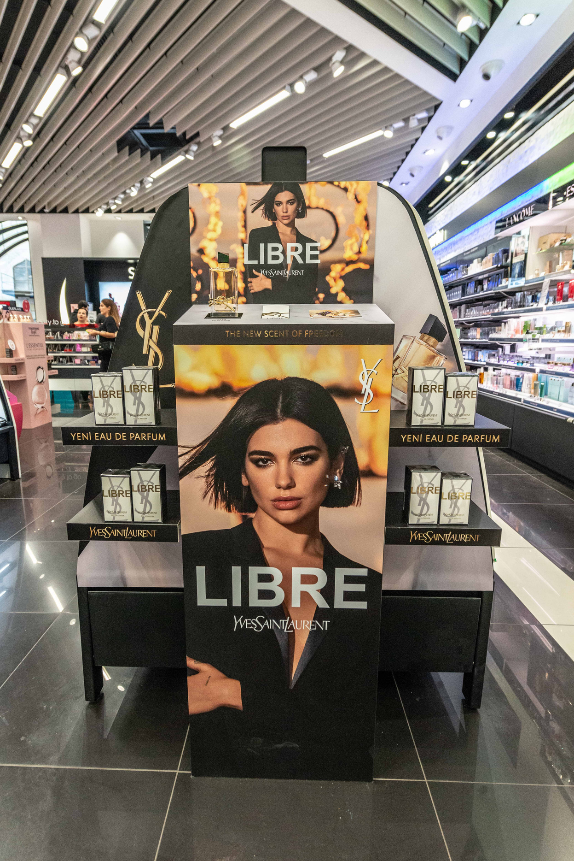
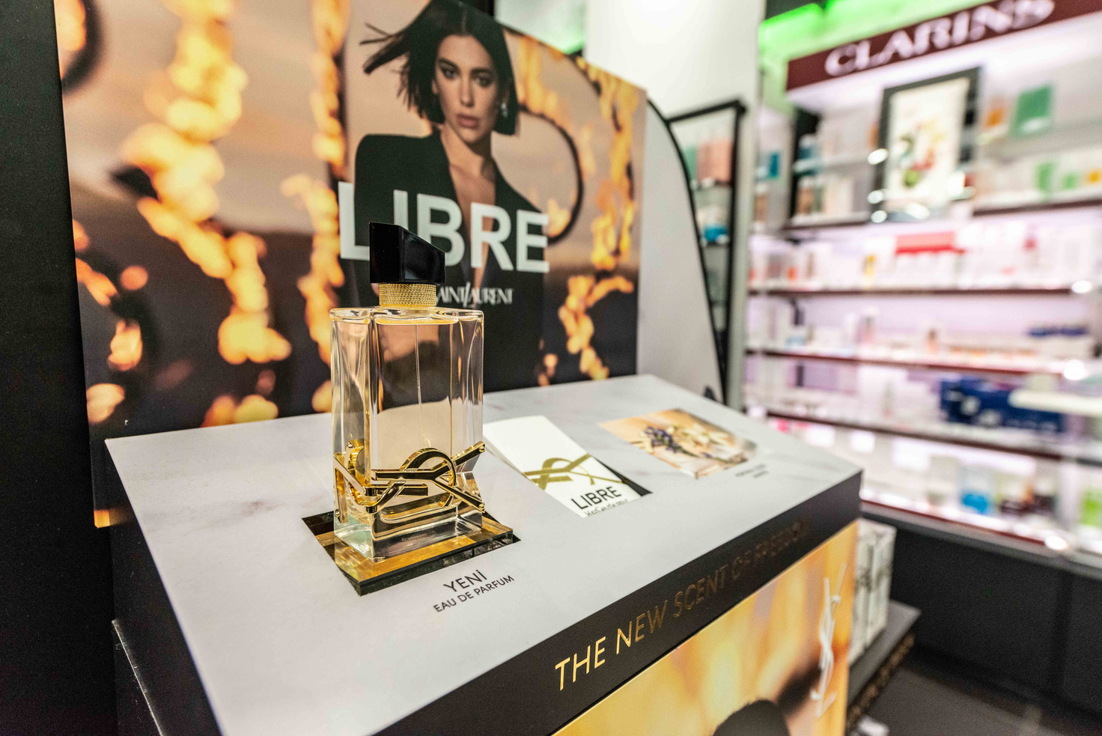
OUR WORKS
Project Name
Location
YSL LIBRE LAUNCH
İstanbul/Türkiye
SUVAR GROUP
The main theme was to highlight the brand's modern, liberated, and elegant image, and to showcase the powerful female character.

Slide 22
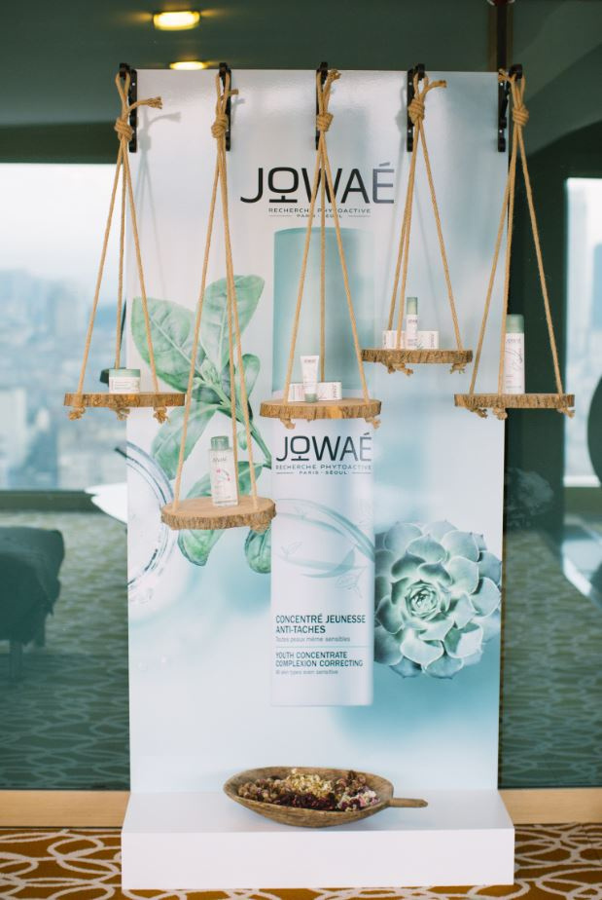
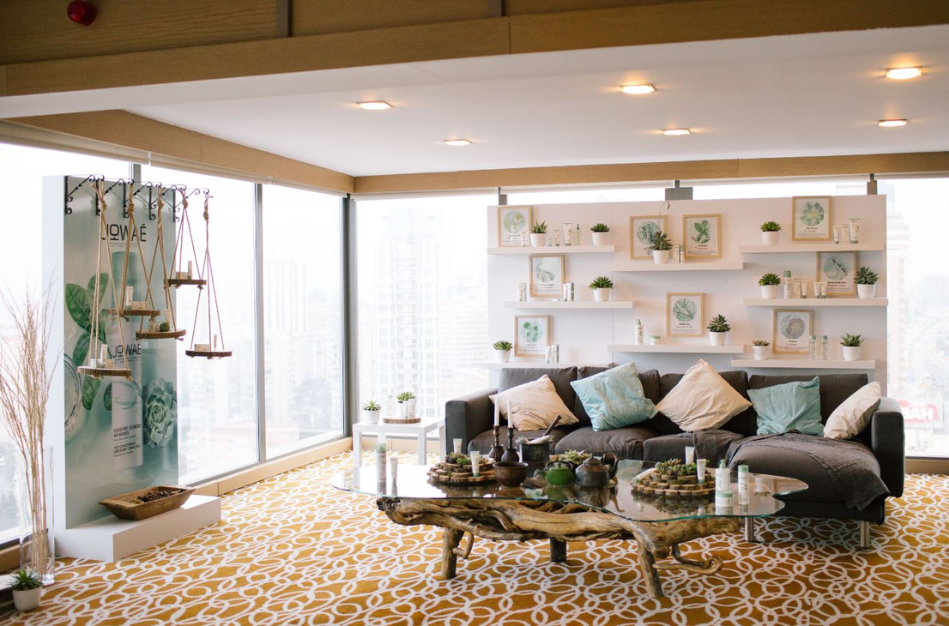
OUR WORKS
Project Name
Location
JOWAE
Renaissance Polat Bosphorus Hotel İstanbul/Türkiye
SUVAR GROUP
The main theme was crafted to reflect the elegant impact of nature and JOWAÉ’s design approach, harmonized with natural elements. Drawing inspiration from the purity of nature, we created an elegant atmosphere.

Slide 23
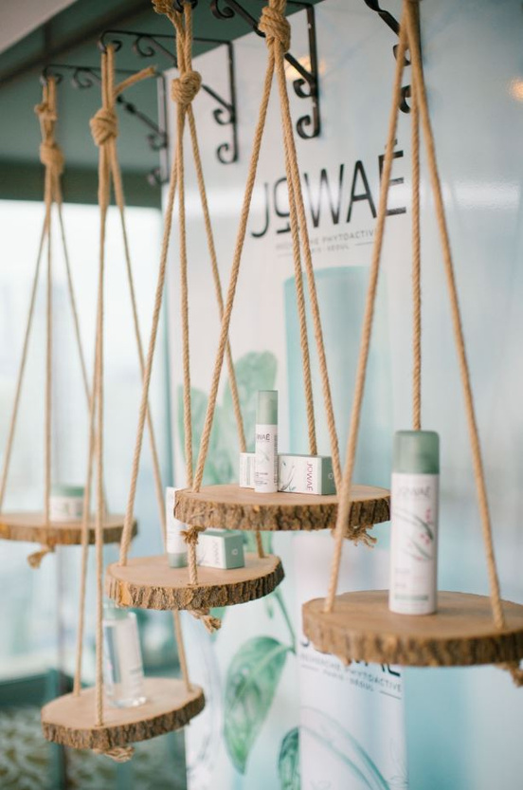
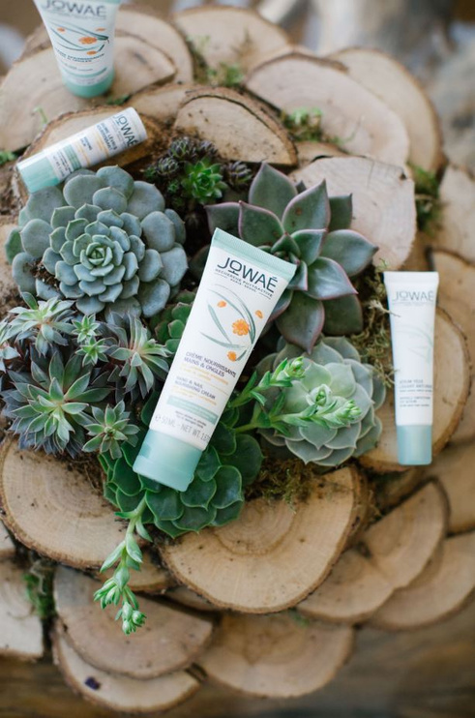

OUR WORKS
Project Name
Location
JOWAE
Renaissance Polat Bosphorus Hotel İstanbul/Türkiye
SUVAR GROUP
Wooden and stone textures, green plants, and pastel tones symbolize the power of nature and the natural balance of the skin.

Slide 24


OUR WORKS
Project Name
Location
JOWAE
Renaissance Polat Bosphorus Hotel İstanbul/Türkiye
SUVAR GROUP
We crafted a space that seamlessly integrates with nature, while embodying the cozy comfort of your own home.

Slide 25



OUR WORKS
Project Name
Location
Maison Francis Kurkdjian Launch
Soho House İstanbul/Türkiye
SUVAR GROUP

Slide 26






Social Responsibility
Project Name
Location
Sustainable Education
Kars/Türkiye
SUVAR GROUP
‘’Sustainable Education” project, aimed at helping schools in Kars, a region in Eastern Turkey, where many schools face significant challenges due to limited resources.We collected old display stands and creatively transformed them into functional bookshelves and cabinets.All the materials used in this project were recycled, helping reduce waste and promoting a more sustainable approach to resource management.

Slide 27




Social Responsibility
Project Name
Location
Library Renovation at an Elementary School
Kahramanmaraş/Türkiye
SUVAR GROUP
This project aimed to provide students with access to books and create an environment that fosters a love for reading and learning.
Before
After

Slide 28

REFERENCES
SUVAR GROUP

Slide 29
REFERENCES
SUVAR GROUP
THANK YOU...

